Slide 1
Data Mining (CS 451)
JAN-MAY’ 18
PRAGYA VERMA

Slide 2
RECAP
A Pattern-Growth Approach for Mining Frequent Itemsets
Mining Frequent Itemsets Using the Vertical Data Format
Pattern Evaluation Methods

Slide 3
CONTENTS
Cluster Analysis: Basic Concepts and Methods
What is Cluster Analysis?
Requirements for Cluster Analysis
Overview of Basic Clustering Methods
Partitioning Methods
k-Means
k-Medoids
Hierarchical Methods
Density Based Methods
Evaluation of Clustering

Slide 4
What is Cluster Analysis?
Cluster Analysis or simply clustering is the process of partitioning a set of data objects (or observations) into subsets
Each subset is a cluster, such that objects in a cluster are similar to one another, yet dissimilar to objects in other clusters.
The set of clusters resulting from a cluster analysis can be referred to as clustering.
Clustering is also referred to as automatic classification.
Also known as data segmentation

Slide 5
Requirements for Cluster Analysis
The following are the typical requirements of clustering in data mining:
Scalability
Ability to deal with different types of attributes
Ability to deal with noisy data
Insensitivity to input order
Capability of clustering high-dimensional data
Constraint based clustering
Interpretability and usability

Slide 6
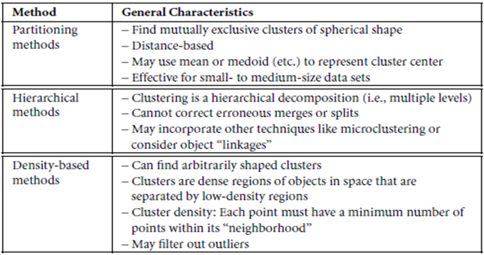
Overview of Basic Clustering Methods

Slide 7
Partitioning Methods
The simplest and most fundamental version of cluster analysis is partitioning, which organizes the objects of a set into several exclusive groups or cluster.
Assumption: The number of clusters is given as background knowledge.
Formally, given a set, D, of n objects, and k, the number of clusters to form, a partitioning algorithm organizes the objects into k partitions (k ≤ n), where each partition represents a cluster.
The clusters are formed to optimize an objective criterion such as dissimilarity function based on distance, so that the objects within a cluster are “similar” to one another and “dissimilar” to objects in other clusters.

Slide 8
Partitioning Methods: k-Means
Suppose a data set, D, contains n objects in Euclidean space.
Partitioning methods distribute the objects in D into k clusters C₁, C₂,..C_{k}, that is C_{i} ⊂ D and C_{i} ∩C_{j} = ∅ for (1 ≤ i,j ≤ k).
An objective function is used to assess the partitioning quality so that objects within a cluster are similar to one another but dissimilar to objects in other clusters.
A centroid based partitioning technique uses the centroid of a cluster, C_{i}, to represent that cluster.
The centroid can be defined in various ways such as by the mean or medoid of the objects (or points) assigned to the cluster.

Slide 9

Partitioning Methods: k-Means (Contd.)
The difference between an object p ϵ C_{i} and c_{i}, the representative of the cluster is measured by dist(p, c_{i}) where dist(x, y) is the Euclidean distance between two points x and y.
The quality of the cluster C_{i} can be measured by the within-cluster variation, which is the sum of squared error between all objects in C_{i} and the centroid c_{i}, defined as
Where E is the sum of squared error for all objects in the data set; p is the point in space representing a given object, and c_{i} is the centroid of the cluster C_{i}

Slide 10
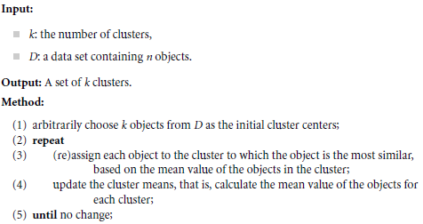
Partitioning Methods: k-Means (Contd.)
k-Means Algorithm:

Slide 11

Partitioning Methods: k-Medoids
The k-Means algorithm is sensitive to outliers.
Thus, instead of taking the mean value of the objects in a cluster as a reference point, we can pick actual objects to represent the clusters, using one representative object per cluster.
Each remaining object is assigned to the cluster of which the representative object is the most similar.
An absolute-error criterion is used, defined as
Where E is the sum of absolute error for all objects p in the data set, and o_{i} is the representative object of C_{i}

Slide 12
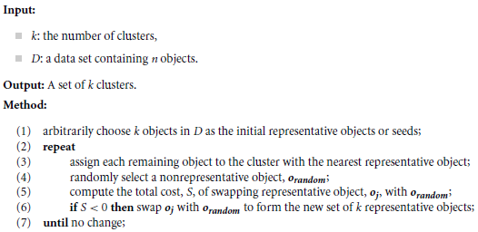
Partitioning Methods: k-Medoids (Contd.)
k-Medoid Algorithm

Slide 13
Hierarchical Methods
A hierarchical clustering method works by grouping data objects into a hierarchy or “tree” of clusters.
Representing data objects in the form of clusters in useful for data summarization and visualization.
A hierarchical clustering method can be either agglomerative or divisive, depending on whether the hierarchical decomposition is formed in bottom-up (merging) or top-down (splitting) fashion.

Slide 14
Hierarchical Methods: Agglomerative Clustering
An agglomerative clustering method uses a bottom-up strategy.
It typically starts by letting each object form its own cluster and iteratively merges clusters into larger and larger clusters, until all the objects are in a single cluster or certain termination conditions are satisfied.
The single cluster becomes the hierarchy’s root.
For the merging step it finds two clusters that are closest to each other, and combines the two to form one cluster.
An agglomerative clustering requires at most n iterations.

Slide 15
Hierarchical Methods: Divisive Clustering
A divisive hierarchical clustering method employs a top-down strategy.
It starts by placing all objects in one cluster, which is the hierarchy’s root.
It then divides the root into several smaller sub-clusters, and recursively partitions those clusters into smaller ones.
The partitioning process continues until each cluster at the lowest level is coherent enough – either containing only one object, or the objects within a cluster are sufficiently similar to each other.
In either agglomerative or divisive hierarchical clustering, a user can specify the desired number of clusters as a termination condition.

Slide 16
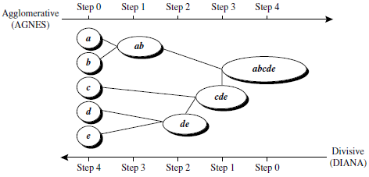
Hierarchical Methods: Agglomerative vs. Divisive Clustering
Agglomerative and Divisive Hierarchical Clustering on data objects {a, b, c, d, e}

Slide 17
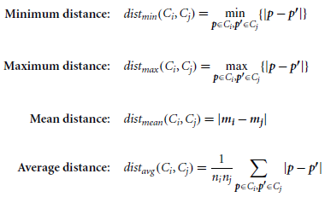
Distance Measures
When using an agglomerative method or a divisive method, a core need is to measure distance between two clusters, where each cluster is generally a set of objects.
Four widely used measures for distance between clusters are as follows:

Slide 18
Density-Based Methods
Partitioning and Hierarchical methods are designed to find spherical-shaped clusters. They have difficulty finding clusters of arbitrary shape.
To find clusters of arbitrary shape, we can model clusters as dense regions in data space, separated by sparse regions. This is the main strategy behind density-based clustering methods.
The density of an object o can be measured by the number of objects close to o.
DBSCAN (Density-Based Spatial Clustering of Applications with Noise) finds core objects, that is, objects that have dense neighborhood.

Slide 19
Density-Based Methods: DBSCAN
It connects core objects and their neighborhoods to form dense regions as clusters.
A user specified parameter ϵ > 0 is used to specify the radius of a neighborhood.
The ϵ-neighborhood of an object o is the space within a radius ϵ centered at o.
Due to fixed neighborhood size parameterized by ϵ, the density of a neighborhood can be measured simply by the number of objects in the neighborhood.
To determine whether a neighborhood is dense or not, DBSCAN uses another user-specified parameter, MinPts, which specifies the density threshold of dense regions.

Slide 20
Density-Based Methods: DBSCAN (Contd.)
An object is core object if the ϵ–neighborhood of the object contains at least MinPts objects.
Given a set, D, of objects, we can identify all core objects with respect to the given parameter ϵ and MinPts.
For a core object q and an object p, we say that p is directly density-reachable from q (with respect to ϵ and MinPts) if p is within the ϵ neighborhood of q.
An object p is directly density-reachable from q if and only if q is a core object and p is in the ϵ-neighborhood of q.

Slide 21
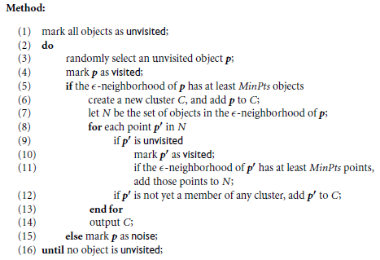
Density-Based Methods: DBSCAN (Contd.)
DBSCAN Algorithm

Slide 22
Evaluation of Clustering
The major task of clustering evaluation include the following:
Assessing the clustering tendency
Determining the number of clusters in a data set
Measuring clustering quality

Slide 23
Evaluation of Clustering: Assessing Clustering Tendency
Clustering tendency assessment determines whether a given data set has a non-random structure, which may lead to meaningful clusters.
Consider a data set that does not have any non-random structure, such as a set of uniformly distributed points in a data space.
Even though a clustering algorithm may return clusters for the data, those clusters are random and are not meaningful.
The Hopkin Statistic is a spatial statistic that tests the spatial randomness of a variable as distributed in a space.

Slide 24
Evaluation of Clustering: Assessing Clustering Tendency (Contd.)
Given a data set, D, which is regarded as a sample of a random variable, o, we want to determine how far away o is from being uniformly distributed in the data space.
The Hopkin Statistic is calculated as follows:
Sample n points uniformly from D. For each point p_{i}, we find the nearest neighbor of p_{i} in D. Let x_{i} be the distance between p_{i} and its nearest neighbor in D. That is,

Slide 25


Evaluation of Clustering: Assessing Clustering Tendency (Contd.)
Sample n points uniformly from D For each q_{i}, we find the nearest neighbor of q_{i} in D – {q_{i}}, and let y_{i} be the distance between q_{i} and its nearest neighbor in D – {q_{i}}. That is,
Calculate the Hopkin Statistic, H, as
If D were uniformly distributed, H would be about 0.5

Slide 26
Evaluation of Clustering: Measuring Clustering Quality
Ground Truth is the ideal clustering that can exist.
If ground truth is available, it can be used extrinsic methods, which compare the clustering against the ground truth and measure.
If ground truth is unavailable, we can use intrinsic methods, which evaluate the goodness of a clustering by considering how well the clusters are separated.
Ground truth can be considered as supervision in the form of “cluster labels”.
Hence, extrinsic methods are also known as supervised methods, while intrinsic methods are unsupervised methods.

